Slide 1
Introduction:
Book Arts Collaborative Business Operation Software
Chris Eller • Michael Gallegos • Edith Tena-Lagunas

Slide 2
Our Team
Christopher Eller - Coding is about solving problems.
Michael Gallegos - Not a lot of experiences, but this is a start
Edith Tena-Lagunas - No idea what I’m doing, and it’s working.
A brief introduction of us, to you.

Slide 3
Our Client
A student-managed business in downtown Muncie tied to the BSU English department that focuses on letter-press and hand-sewing of books. In their fourth year of operation, they have decided they need our help.
Book Arts Collaborative

Slide 4
First Meeting
Introductions
Descriptions of the problems
Tour of the facility
Discussion of resources available
Wish-list was given, narrowed by practicality and time
Their view by the time we left: Excitement.

Slide 5
The PROJECT ™
Java - Multi-platform and versatile, easy to maintain
Maven - Easy dependency management
Coffee
Lots of coffee
And probably snacks.
While the construction of a software suite is probably going to be a bit ambitious, we hope to solve the client’s problems in a form that at least improves their overall experience running and interacting with their business and cooperating businesses.
A good starting point is the most important thing for this project, because if nothing else it can form the basis of another year’s capstone to expand upon what we have. This is a learning experience for everyone.

Slide 6
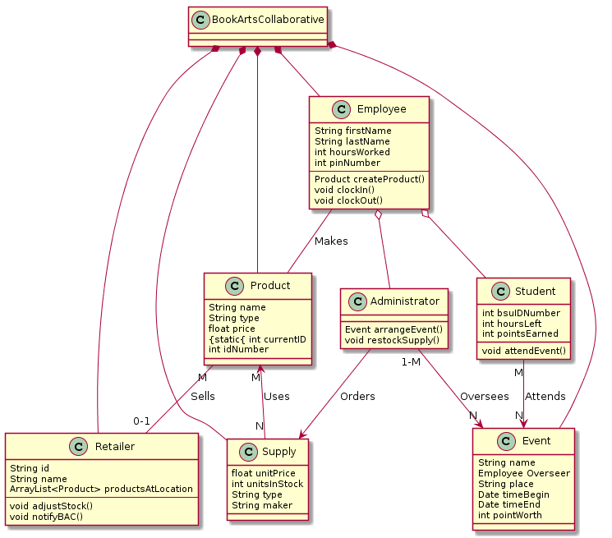
Domain

Slide 7
Planned Features
Time-clock functions for students
Central location for tracking time on-site
Event-based tracking when students are attending an event.
Cost and product tracking for employees
When creating a book or other product, the supplies listed will be tracked
The tracked supplies will be kept along with the product and who made it
Created products can be assigned to retailer locations who will be notified about the product.
Product location and status tracking for retailers and employees
Once a product has been sent to a retailer, the client will be able to see if it has been sold
Retailers will be able to explain the reason for product loss if necessary
A recommended price based upon the production cost will be recommended

Slide 8
The PLAN ™
Panic.

Slide 9
The PLAN ™
Highest priority is the time-clock system
It impacts students now
People’s grades (and therefor graduation) rely on this
Even a small system in place will help
By taking a smaller bite, we have plenty of time to review with the client and ensure what we deliver is of high quality.
… And also panic.

Slide 10
The Part Where You Ask Questions
And help us kill time by doing so.

